Slide 1
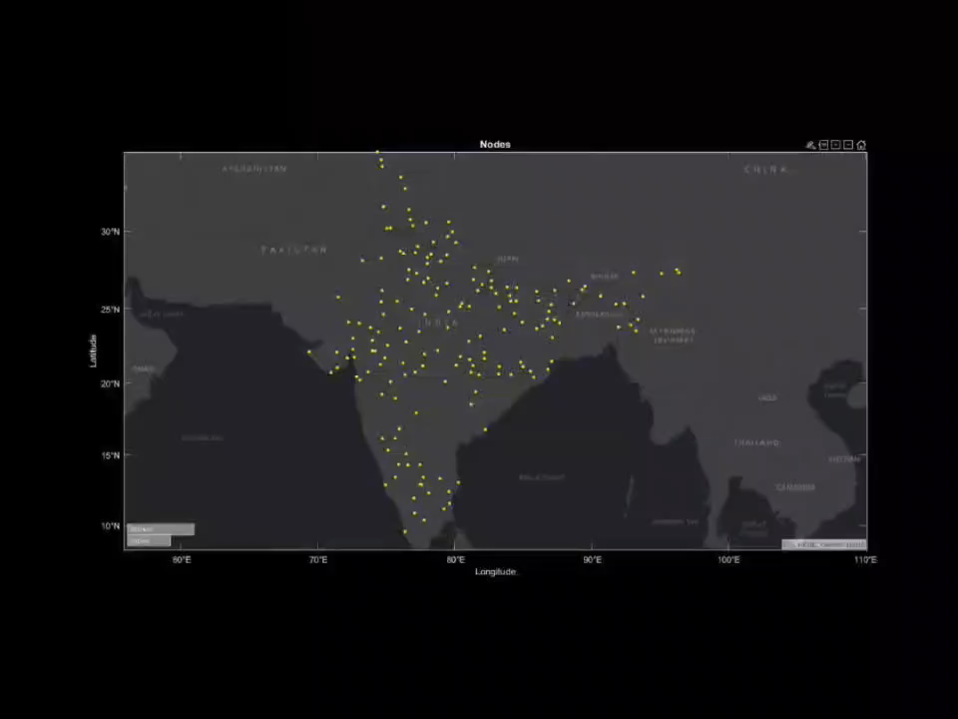
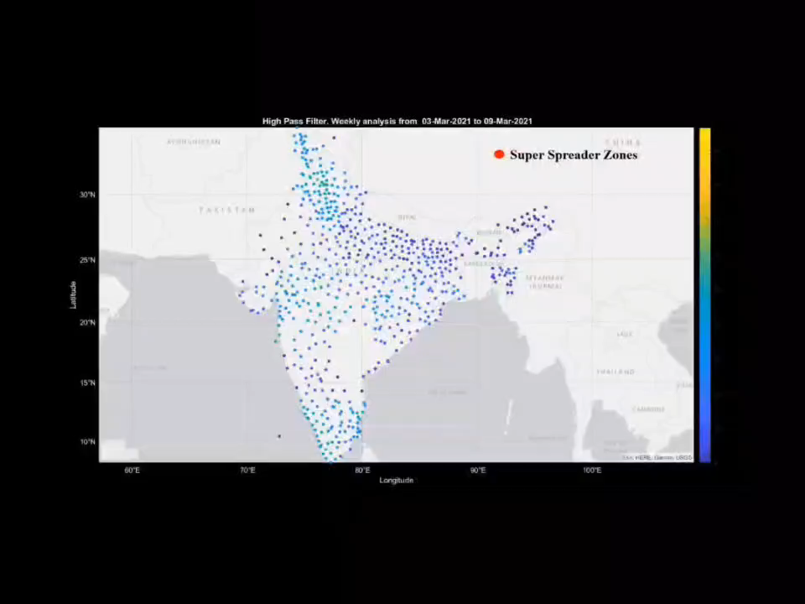
COVID-19 SUPER SPREADER ANALYSIS WITH GRAPH SPECTRAL PROCESSING
Indian Districts
High Pass Analysis

Slide 2
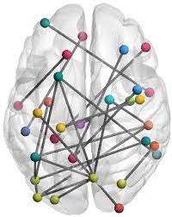
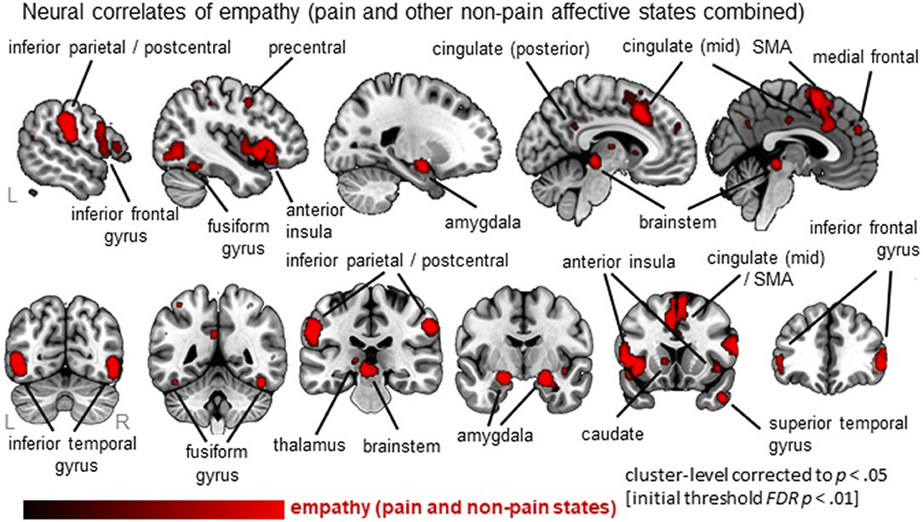
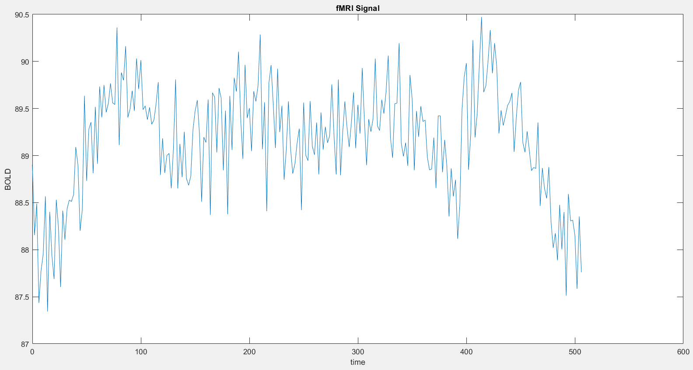
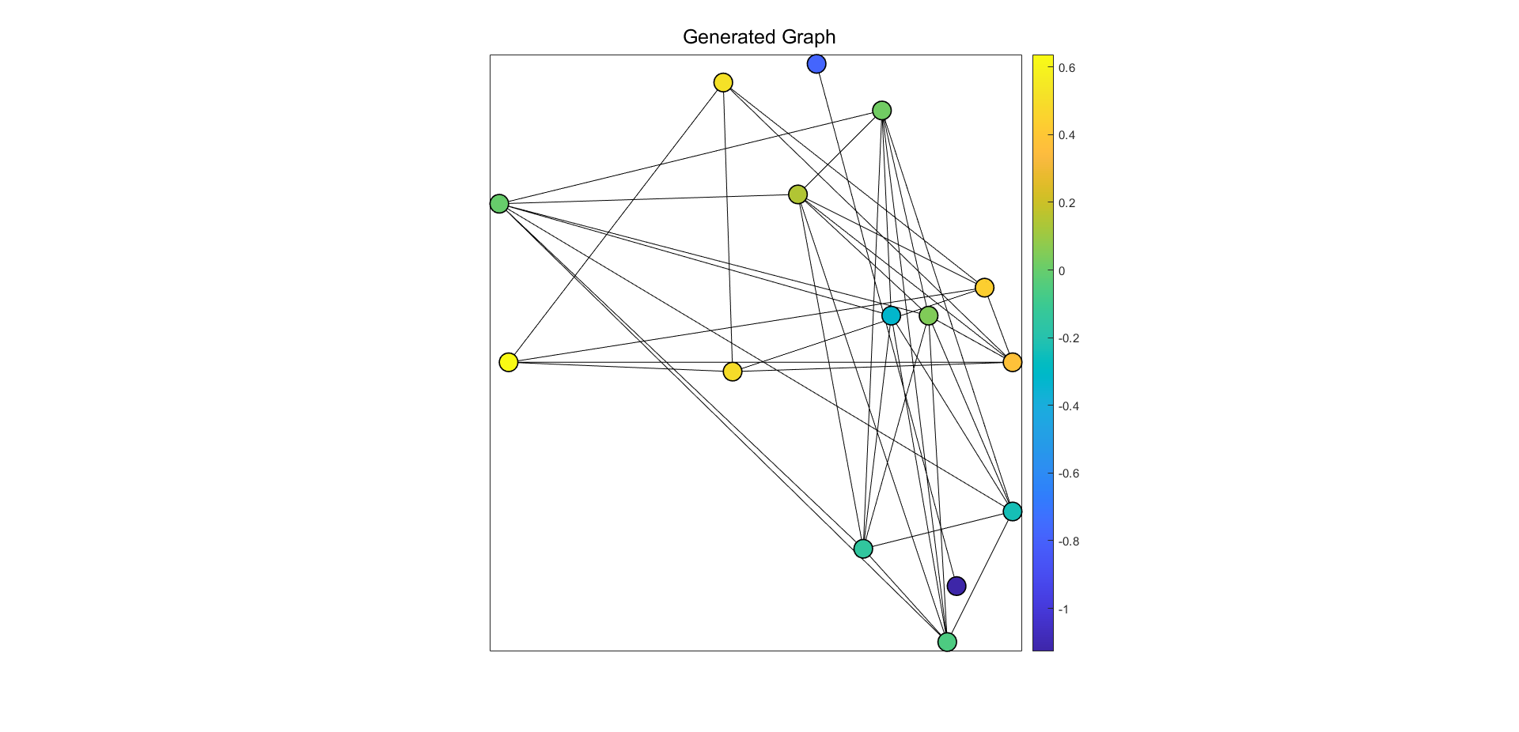
BRAIN CONNECTOME ANALYSIS FOR EMPATHY NETWORKS OVER fMRI SIGNALS USING GRAPH SIGNAL PROCESSING
Brain Empathy Regions
Data
fMRI BOLD Signals of 20 subjects, sampled every 2s, for 8 minutes
Time-series data obtained for every voxel in the whole brain system
Graph Learning
Node Similarity
Smoothness Model
Sparsity Correlation Model
Spectral Templates

